Slide 1

PBEL Virtual Internship
Project Title: Weather Forecasting Application
Submitted By:
Name: Aditya singh
College: United College of engineering and research
Submitted To:
Name: Mr. Deepanshu Kumar

Slide 2
Declaration
I hereby declare that this project report titled “Weather Forecasting Application ” is a result of my own work carried out during the IBM PBEL Virtual Internship. The project is original, and no part of it has been copied or submitted elsewhere for any other course or internship.
Acknowledgement
I would like to express my heartfelt gratitude to my Project guide, Mr. Deepanshu Kumar for their valuable support, guidance, and encouragement throughout the project. Their constructive feedback and constant motivation helped me complete this internship successfully.
I also extend my sincere thanks to the IBM PBEL team for offering this incredible opportunity to gain practical experience. My appreciation also goes to my college, United College of Research and Technology, and my peers who supported me during the course of this internship.

Slide 3
Table of Contents
Introduction
The project titled “Weather Forecasting Application ” was developed as part of the IBM PBEL Virtual Internship to gain hands-on experience in full-stack web development. The goal of the project is to design and implement an intuitive, efficient, and feature-rich food delivery platform that replicates functionalities commonly found in industry-leading applications such as Zomato and Swiggy.
The platform empowers users to explore a wide range of restaurants filtered by cuisine type, location, and category. Users can view detailed restaurant pages, browse dynamic menus, add food items to a cart, adjust quantities, and proceed to checkout—all within a seamless single-page application experience. Additionally, users can explore themed categories like Pizza, Biryani, and Burgers, each populated with uniquely styled menu items and real-time imagery via the Pexels API.
Key features of Feasto include:
Dynamic routing using React Router for navigation between restaurant listings, detailed menus, and cart pages.
Live cart management using Context API and Redux for global state updates.
Smooth scrolling animations and visually appealing UI elements powered by Tailwind CSS and Framer Motion.
Responsive design, ensuring accessibility and usability across all screen sizes (mobile, tablet, desktop).
Lazy-loaded image components for performance optimization and faster rendering. This project offered valuable insights into:
Structuring scalable and modular React components.
Handling dynamic data flows and API integration.
Maintaining application-wide state effectively.

Slide 4
2. Technologies Involved
The following technologies and tools were used to build this project:
React.js – For building the user interface and handling dynamic routing.
JavaScript (ES6+) – Core scripting language used across the project.
HTML5 & CSS3 – Used for structuring and styling the components.
Tailwind CSS – For utility-first styling and responsive design.
React Router DOM – For client-side routing and dynamic page rendering.
Redux Toolkit / Context API – For state management (e.g., managing cart items).
Pexels API / Unsplash – For fetching high-quality food and restaurant images.
Vite – For a faster and optimized React development environment.
Git & GitHub – Version control and project repository management.

Slide 5
3. Problems Faced & Solution Implementation
During the development process, several challenges were encountered and resolved:
🔹 Dynamic Data Mapping
Problem: Rendering different menu items for multiple restaurants based on route parameters.
Solution: Used dynamic routing with useParams() and structured the restaurant and menu data using slugs for easy access.
🔹 Cart Functionality & State Management
Problem: Managing cart state globally without prop drilling.
Solution: Implemented React Context API initially, and later transitioned to Redux Toolkit for better scalability and state persistence.
🔹 Responsive UI Design
Problem: Layout broke on smaller screens and felt cluttered with image-heavy components.
Solution: Used Tailwind CSS utility classes to create responsive grids and spacing. Applied parallax effects and animations for a smoother user experience.
🔹 Image Loading & Optimization
Problem: Slow performance due to large image files.
Solution: Used optimized image URLs from Pexels with appropriate resolution and added lazy loading for components.
🔹 Scroll Animation & Smooth Navigation
Problem: Abrupt UI transitions and lack of visual storytelling.

Slide 6
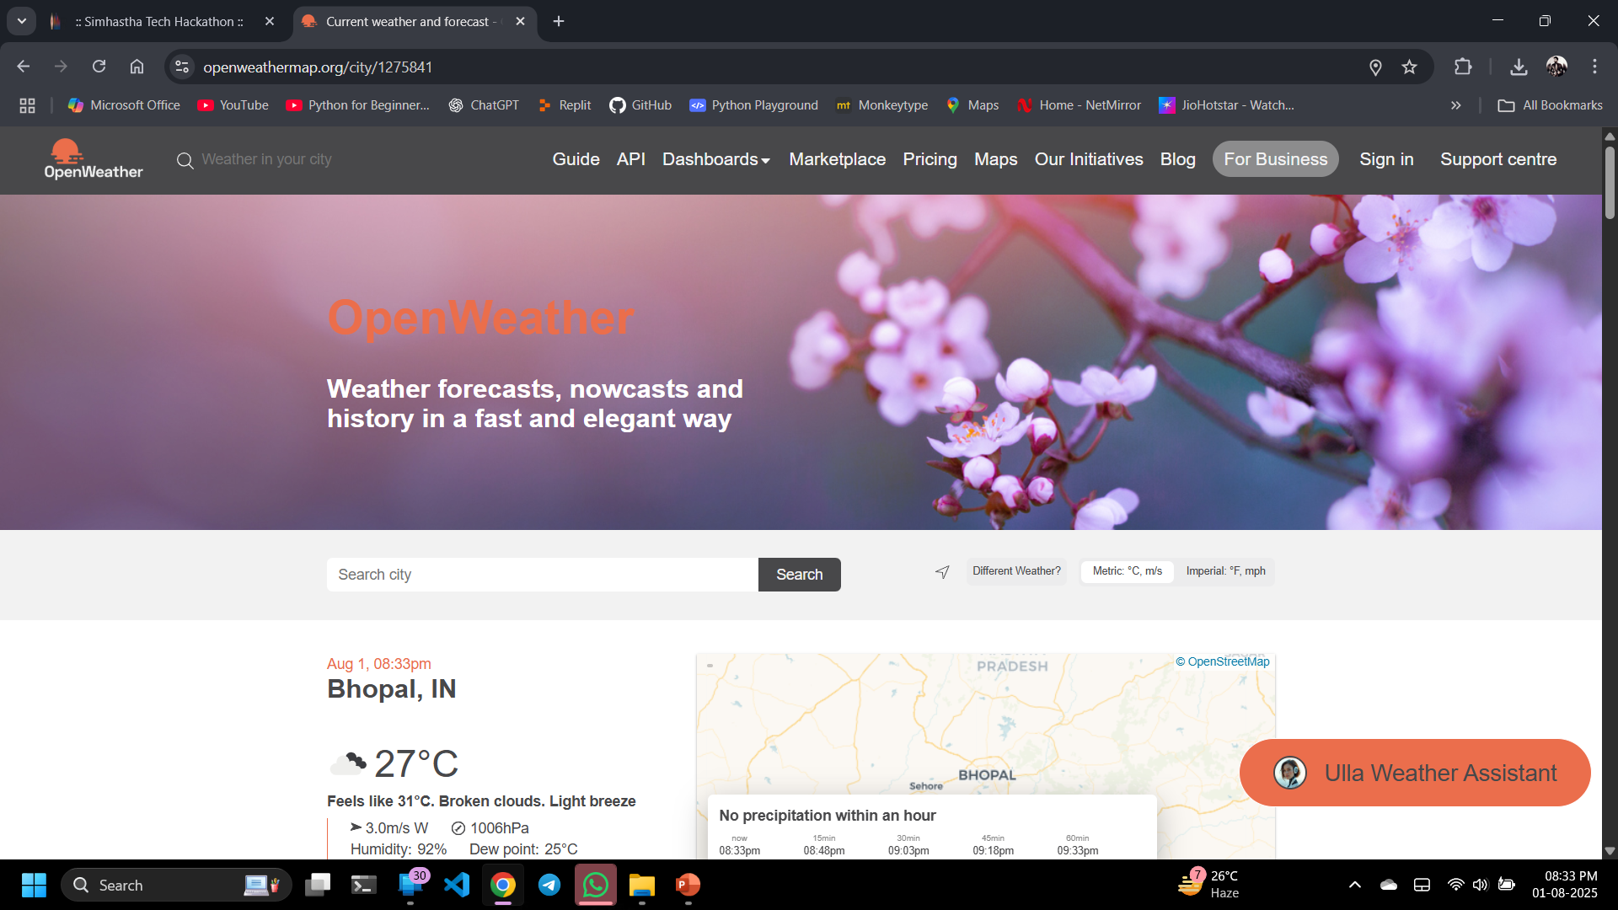
4. Output Screenshot
HOMEPAGE

Slide 7
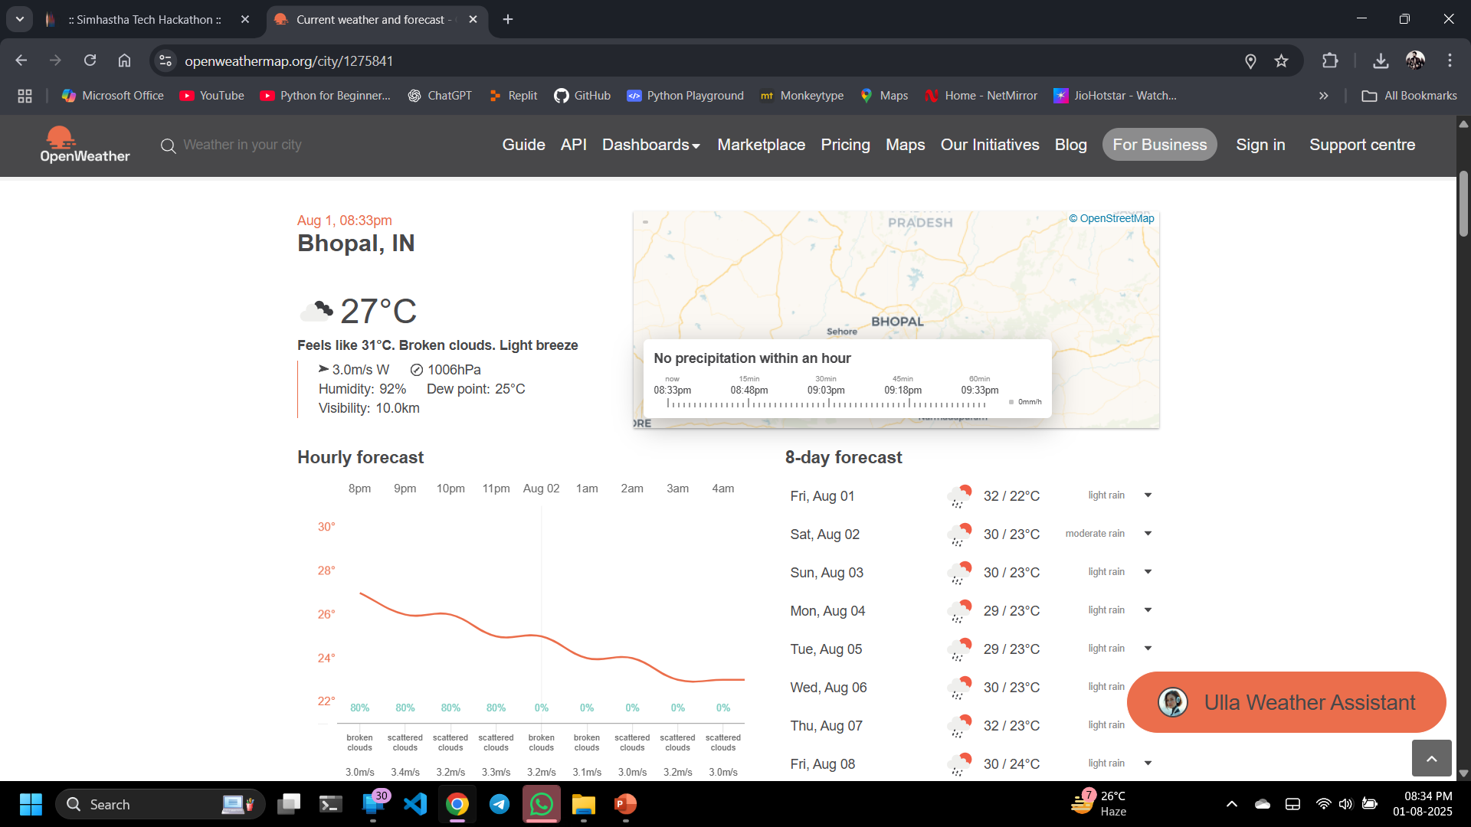

Slide 8
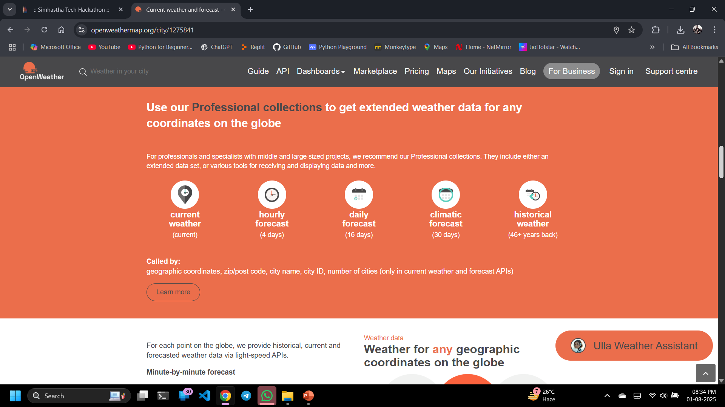
Professional Collections

Slide 9
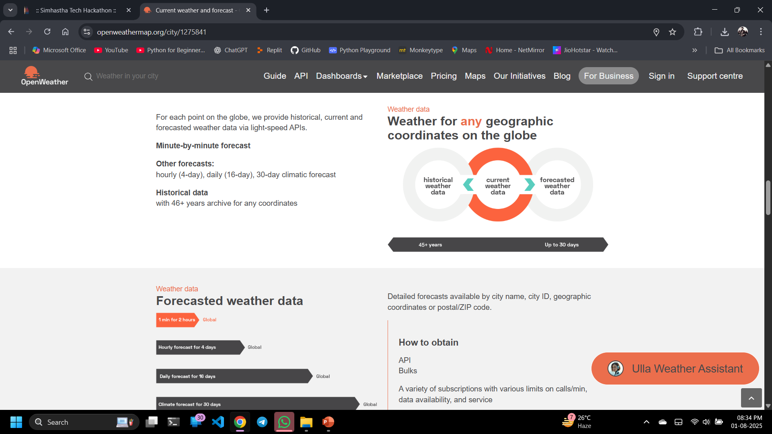

Slide 10
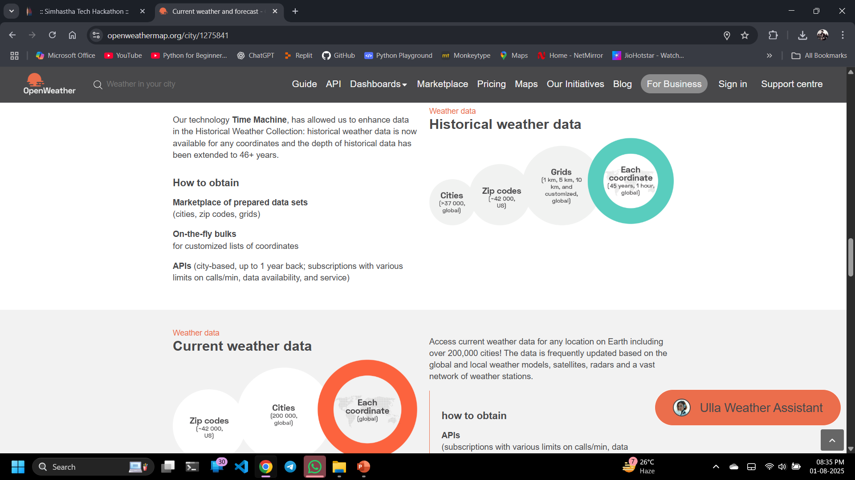
Historical Weather data

Slide 11
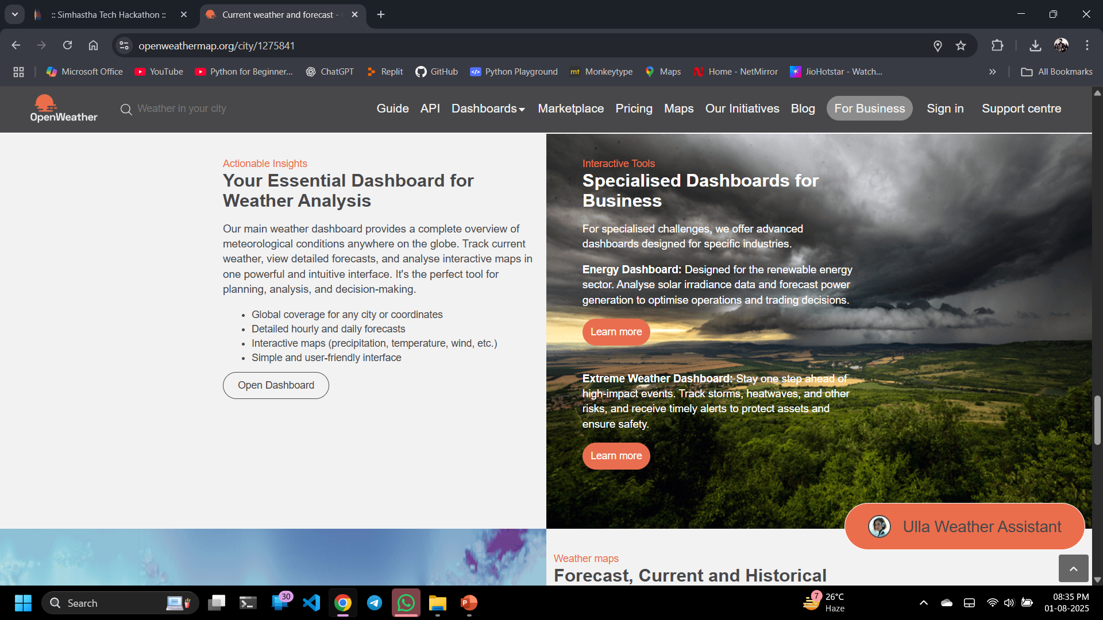

Slide 12
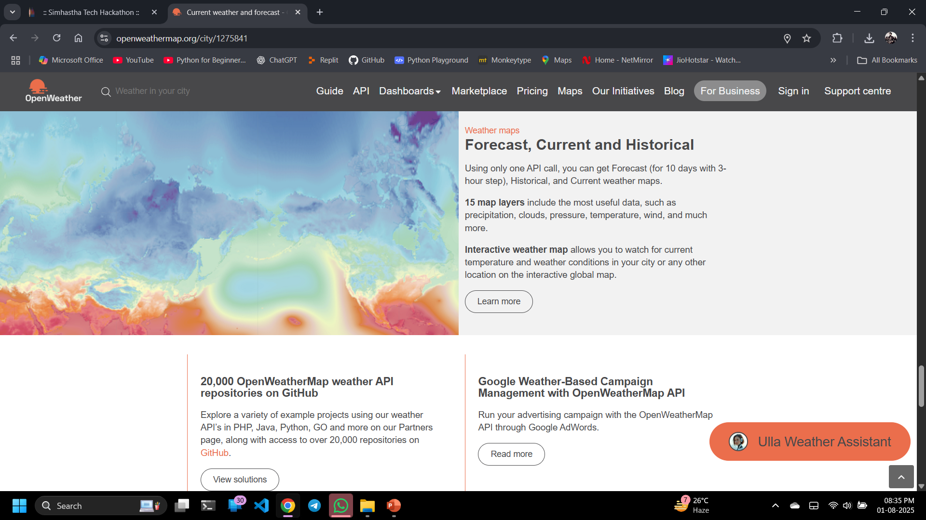

Slide 13
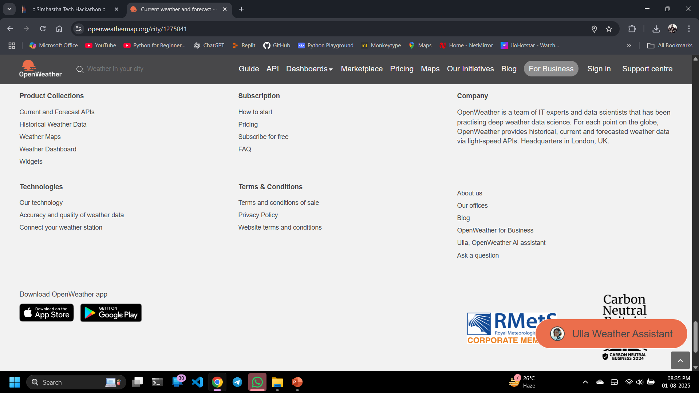
FOOTER

